Slide 1
Object Oriented Programming using Java (ECSE102L)

Slide 2
Outline
Queue
Circular Queue
Priority Queue

Slide 3
Queue
S
In ordinary English, a queue is defined as a waiting line. For example: People are waiting to purchase tickets, where the first person in the line is the first person to get served.
In computer science, we similarly define a queue to be a list in which all additions to the list are made at one end known as rear or tail, and all deletions from the list are made at the other end known as front or head.
A queue is a First In First Out (FIFO) data structure.

Slide 4
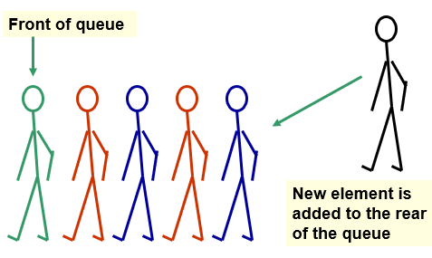
Queue (Cont…)
S
Adding an Element

Slide 5
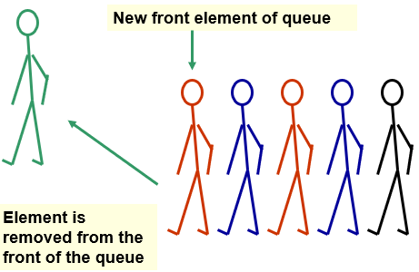
Queue (Cont…)
S
Deleting an Element

Slide 6
Uses of Queue in Computing
S
Printer queue
Keyboard input buffer
Service of a web-server
Multitasking
GUI event queue (click on buttons, menu items)

Slide 7
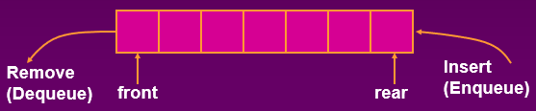
Operations on Queue
S
Enqueuing
  Operation to add a new item at the tail or rear of the queue.
  Condition: Queue is not Full.
Dequeuing
  Operation to delete an element from the front or head.
  Condition: Queue is not Empty.

Slide 8
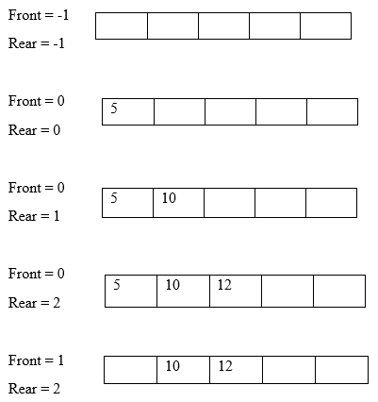
Operations on Queue (Cont…)
S

Slide 9
Implementation of Queue
S
Arrays
  Static: The size of the stack must assign at the beginning.
Linked lists
  Dynamic: Never becomes full.

Slide 10
Implementation of Queue (Cont…)
S
Enqueuing
Enqueue (queue, item, Max, Front, Rear)
If (Rear = = Max - 1)
print “Overflow”
Else
{
If (Front = = -1) //Queue is initially empty
Front=0
Rear = Rear + 1
queue[Rear] = item
}

Slide 11
Implementation of Queue (Cont…)
S
Dequeuing
Dequeue (queue, item, Front, Rear)
If (Front = = - 1 || Front > Rear )
print “Underflow”
Else
{
item = queue[Front]
Front = Front + 1
}

Slide 12
Implementation of Queue (Cont…)
S
Dequeuing
Display (queue, i, Front, Rear)
If(Rear = = -1)
Print “Underflow”
Else
For i = Front to Rear
Print queue[i]

Slide 13
Problem of Normal Queue
S
Can you say the problem by seeing the below array?
Front =2
Rear = 7
 |  | 5 | 10 | 12 | 15 | 4 | 87

Slide 14
Problem of Normal Queue (Cont…)
S
Can you say the problem by seeing the below array?
Front =2
Rear = 7
  We cannot add any element even though there are two empty spaces.
  Here, rear is at 7 i.e. the last location of the array.
What could be the solution?
 |  | 5 | 10 | 12 | 15 | 4 | 87

Slide 15
Solution of the Problem of Normal Queue
S
To shift all the elements to our left end. Then, we have to change the position of front and rear.
Another solution is Circular Queue.

Slide 16
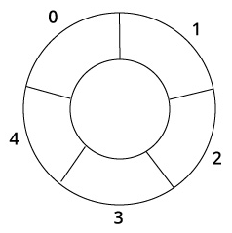
Circular Queue
S
In the circular queue, the first index comes right after the last index.
When we try to add any variable and we reach at the end of queue, we start from the beginning of queue by modulo division with the queue size.
Rear + 1 == 5 // Overflow
Rear = (Rear + 1) % 5 = 0 // Start of queue

Slide 17
Circular Queue (Cont…)
S
When we initialize the queue, we set Front and Rear as -1.
When enqueuing the first element, we set the value of Front as 0.
On enqueuing an element, we circularly increase the value of Rear, and place the new element in the position pointed by Rear.
On dequeuing an element, we return the value pointed by Front and circularly increase the Front.
When dequeuing the last element, we reset the values of Front and Rear as -1.

Slide 18
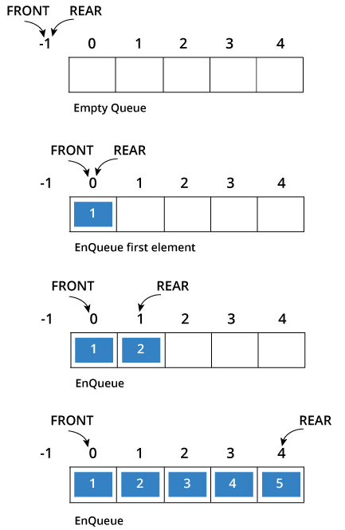
Circular Queue (Cont…)
S
Example

Slide 19
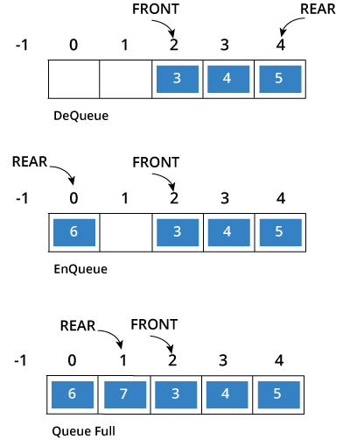
Circular Queue (Cont…)
S
Example (Cont…)

Slide 20
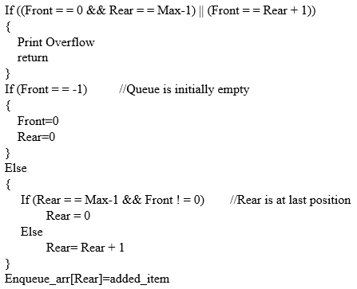
Circular Queue (Cont…)
S
Enqueuing

Slide 21
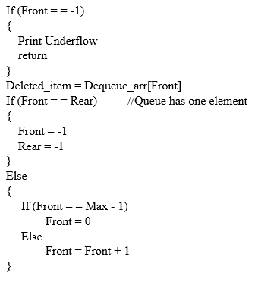
Circular Queue (Cont…)
S
Dequeuing

Slide 22
Priority Queue
S
A priority queue is a special type of queue.
Here, each element is associated with a priority value and served according to its priority.
An element with high priority is dequeued before an element with low priority.
If two elements have the same priority, they are served according to their order in the queue.

Slide 23
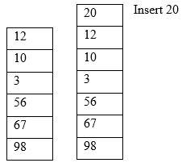
Priority Queue (Cont…)
S
Insertion
    Whenever an element is inserted into queue, priority queue inserts the item according to its priority.

Slide 24
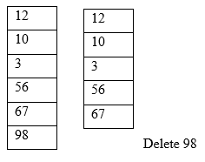
Priority Queue (Cont…)
S
Deletion
  Deletion operation will be the deletion of the first element of the list because it has more priority than other elements of the queue.

Slide 25

